Slide 1
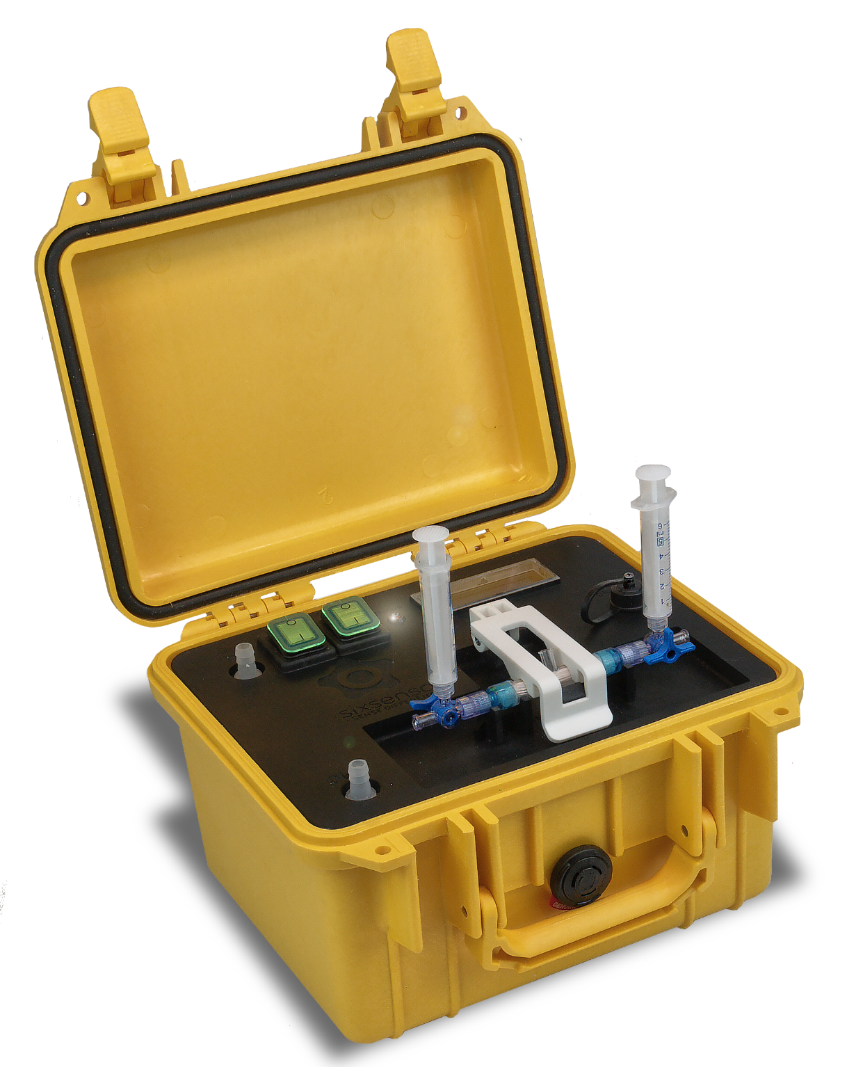
ENHANCEMENT OF MICROBIOLOGICAL ASSESSMENT
Sixsenso aims to change how microbiological water quality is monitored worldwide bringing the lab to the origin of water contamination by rapid microorganism monitoring tools.
SX-CON is a microorganism concentrator module which can rapidly filtrate large volume of water samples (in the order of litres) and elute them in a few millilitres reservoir, providing an increasing concentration factor of some orders of magnitude, depending on the application. It is designed to be portable (with large battery autonomy) and robust to use in the most challenging outdoors' environmental conditions or simply operating in the laboratory.
Combine SX-CON with several microbiological assessment techniques and methods in order to increase their representativeness and enhance their sensitivity, including standard or fluorescence microscopy, Lateral Flow Device (LFD) assays, Defined Substrate Technology (DST) based assays, Nanoparticles-based assays, Antigen-based assays, rRNA-based assays and PCR assays. It has been proven to be suitable for virus, gram negative and gram positive bacteria, and phytoplankton concentration, in fresh water, brackish water and sea water. It has direct application in bathing and recreational waters, ports and harbours water, ballast water IMO-D2 regulation compliance, waste water, regenerated waters, irrigation waters, industrial water and beverage quality control.
SXS-CON
Portable concentrator system
Enhance your microbiological assessment by a rapid on-site pre-concentration step.
Filtrate large volumes of water and elute them in a few mils to easily increase the assay’s sensitivity and sample representativeness reaching target microorganism concentration levels required for your application in a few minutes.
industrial water, fresh water and beverage quality control.
SXS-CON provides large volume water filtration through highly efficient cell trap filters to increase the representativity of microbiological analysis.
Large volume processing followed by an efficient elution procedure provides very high concentrator factors.
Avoid long time-consuming replication or pre-enrichment steps by a rapid on-site concentrator module.
Specifications *
Filtrated sample Volume | From 100 mls to 3.000 mls
Eluted sample Volume | From 0,1 ml to 3 mls
Concentration Factor (CF) | From x10 to x1.000
Flow rate | 200 ml/min @100 rpm. (Powered by 24W peristaltic pump)
Internal Diameter (ID) tubing | From ID 2.4 to 8.0 mm (ID 4,8mm by default)
Power | Internal rechargeable battery – 8 hours continuous operation
Dimensions | 26,5 x 24,5 x 17 cm
Mass | 4,9 Kg
IP rating lid closed/open | IP68 / IP65
* In view of our continual improvements, the designs and specifications of our products may vary from those described.
Sixsenso Technologies S.L
Av. Carl Friedrich Gauss 3, office 350 | 08860 Castelldefels, Barcelona | Spain
info@sixsenso.com | www.sixsenso.com

Slide 2
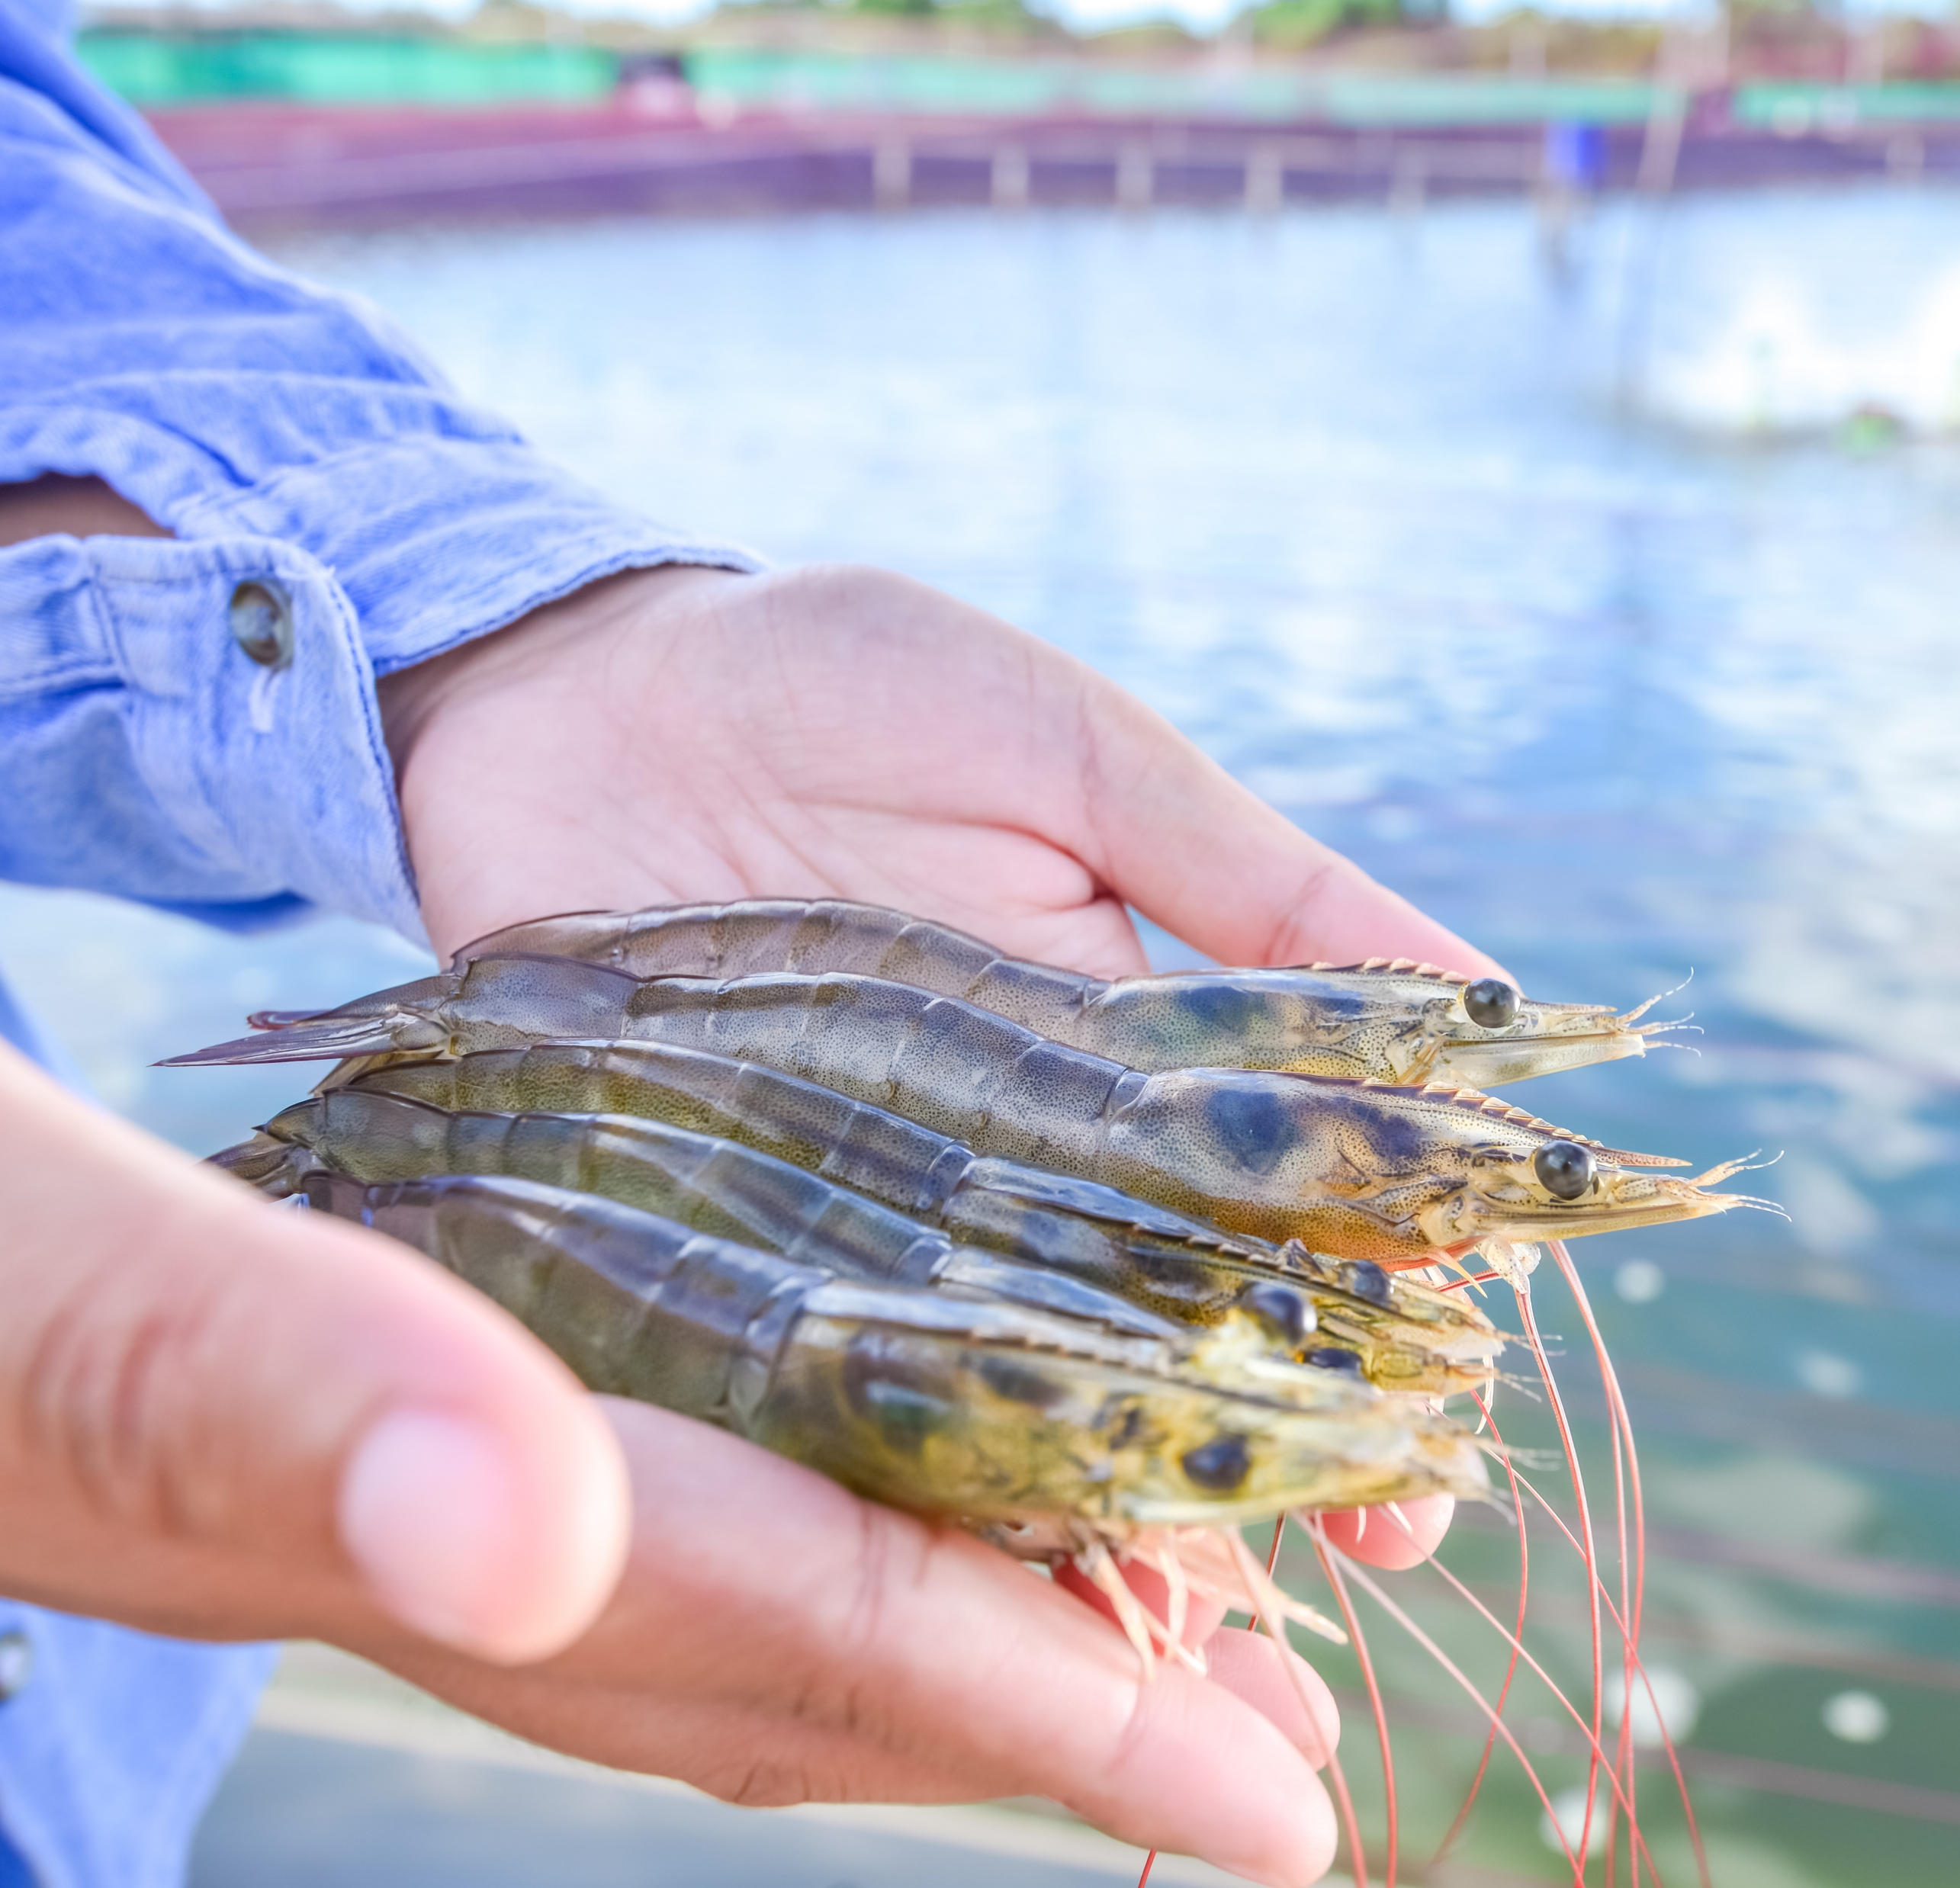
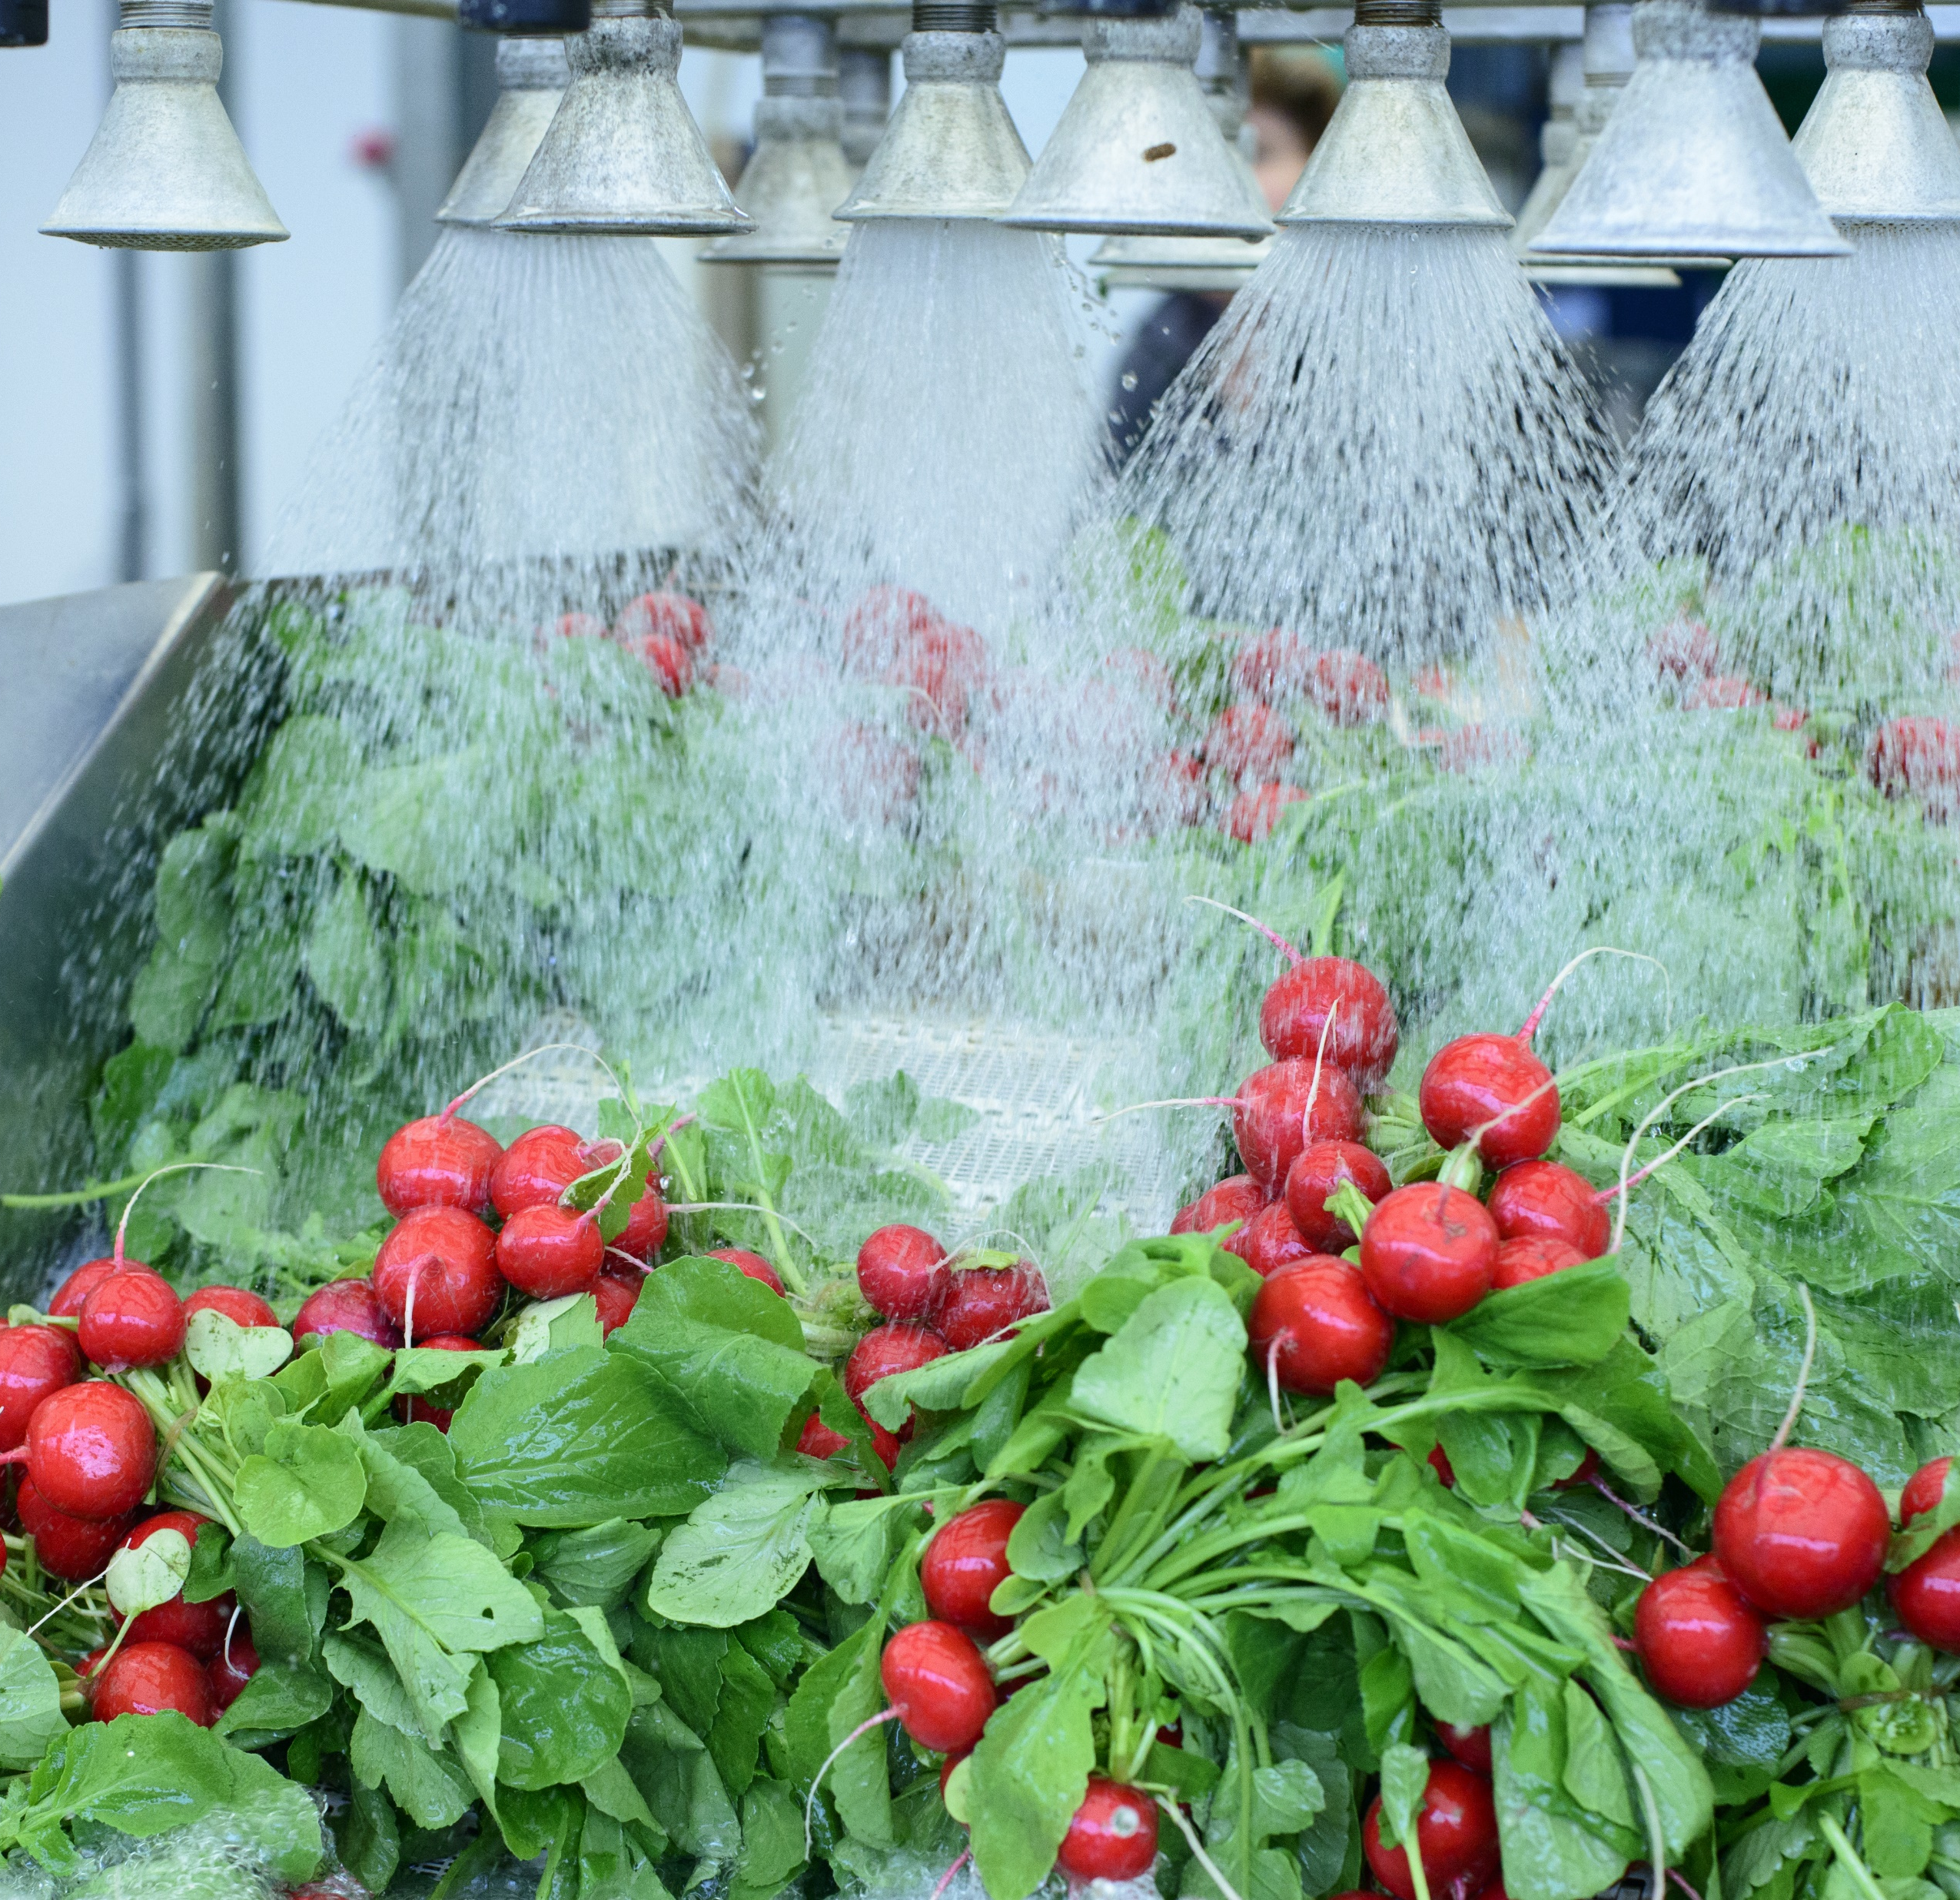
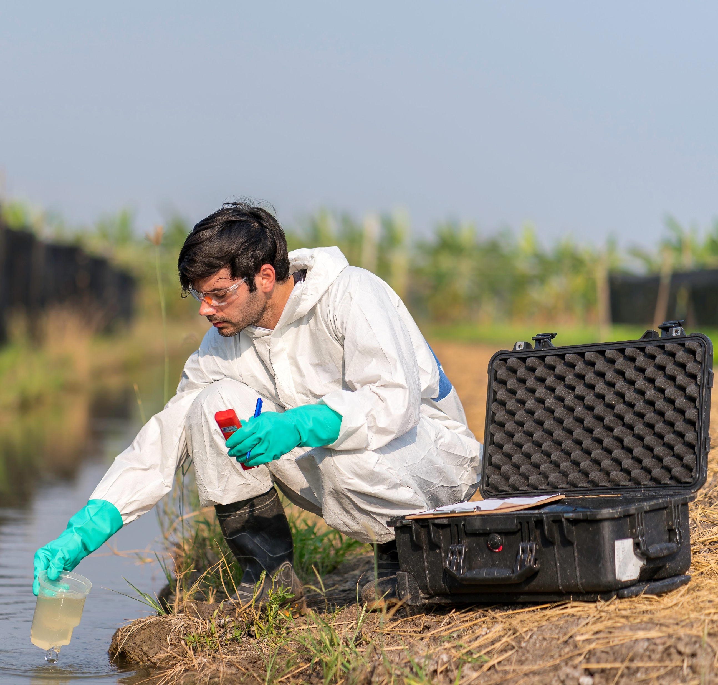
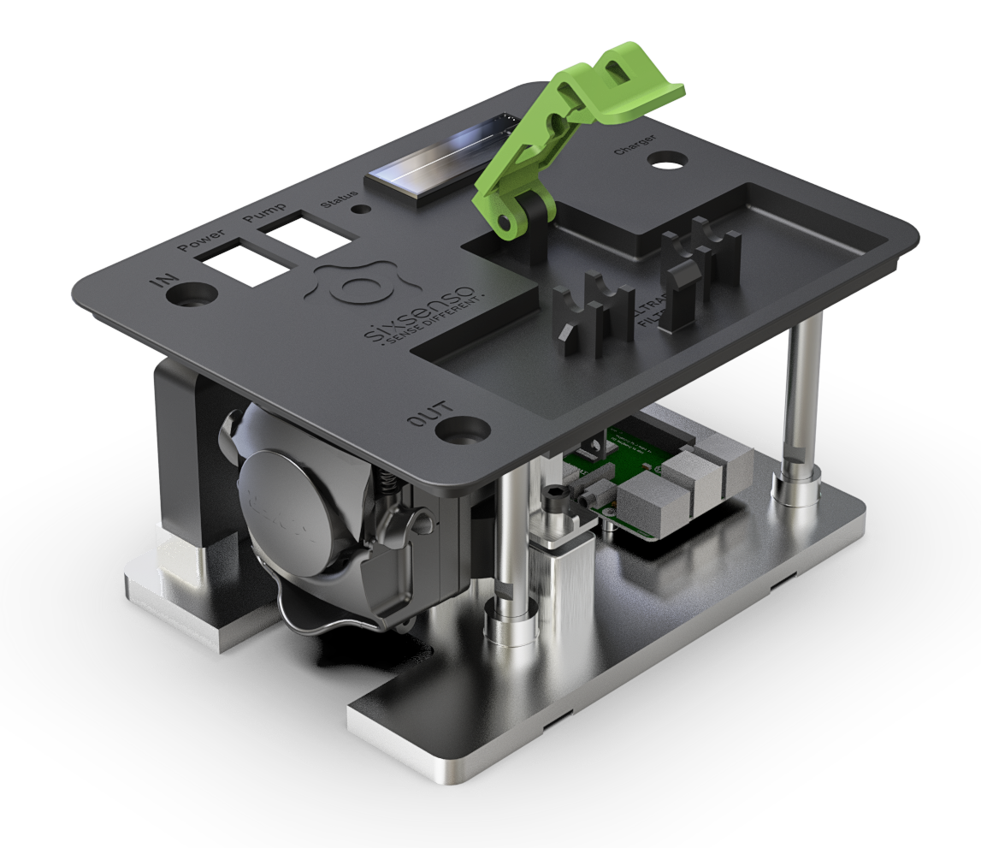
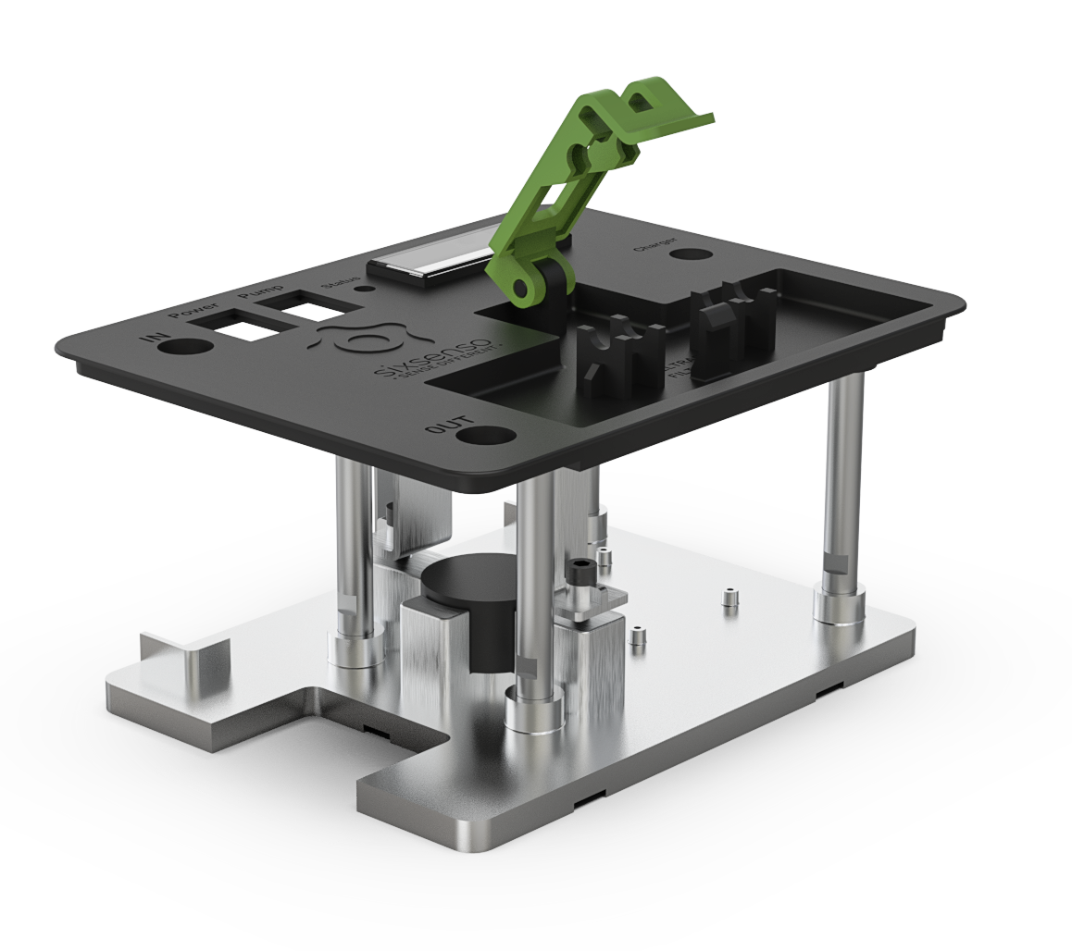
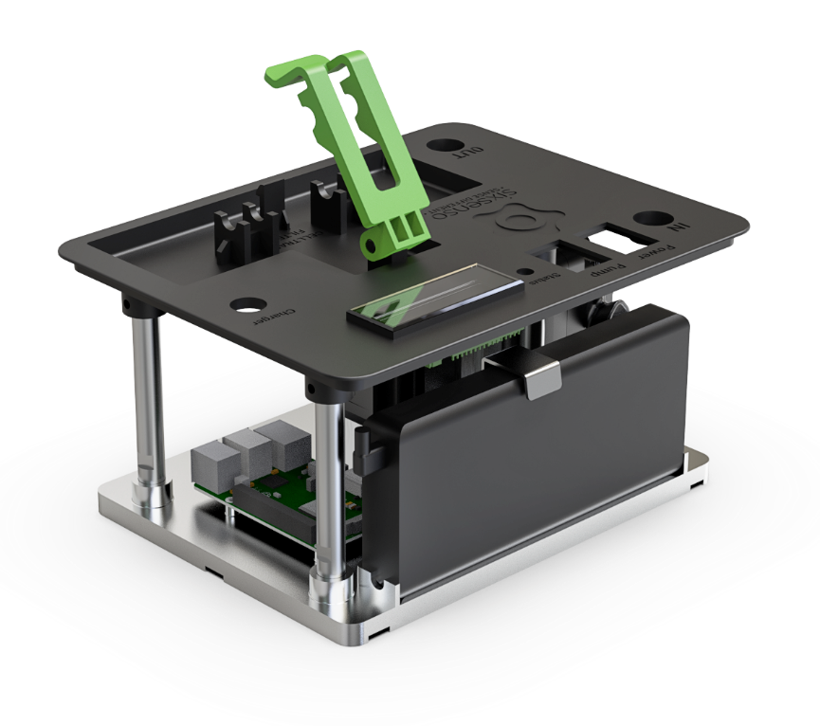
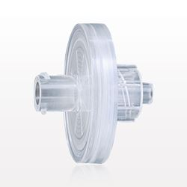
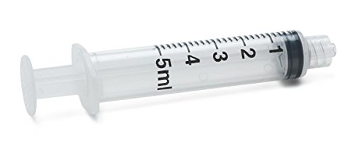
SXS-CON
Enhance rapidly the sensitivity and representativeness of your microbiological assessment by a pre-concentration step.
Portable concentrator system
4
Concentration Kit – Sterilized disposables *
2
3
 | 3x Luer lock 3-port valves
 | 1x Mesh disk filter <40µm
 | 2x Luer lock 5 ml syringes (with elution buffer)
 | 1x Celltrap filter
6
5
1
7
8
Concentrator - Internal features
1 | Integrated 24 W peristaltic pump
2 | LED status signal
3 | Celltrap filter holder
4 | LCD Display 2x16 pixels
5 | Internal vibration absorber
6 | Internal aluminium pillars
7 | Anti-condensation drainage holes
8 | Battery power bank with external Micro-USB battery charger
* Sterilized disposables are for only one use to avoid cross-contamination. Multi-use of disposables could be suitable for evaluation purposes.

Slide 3
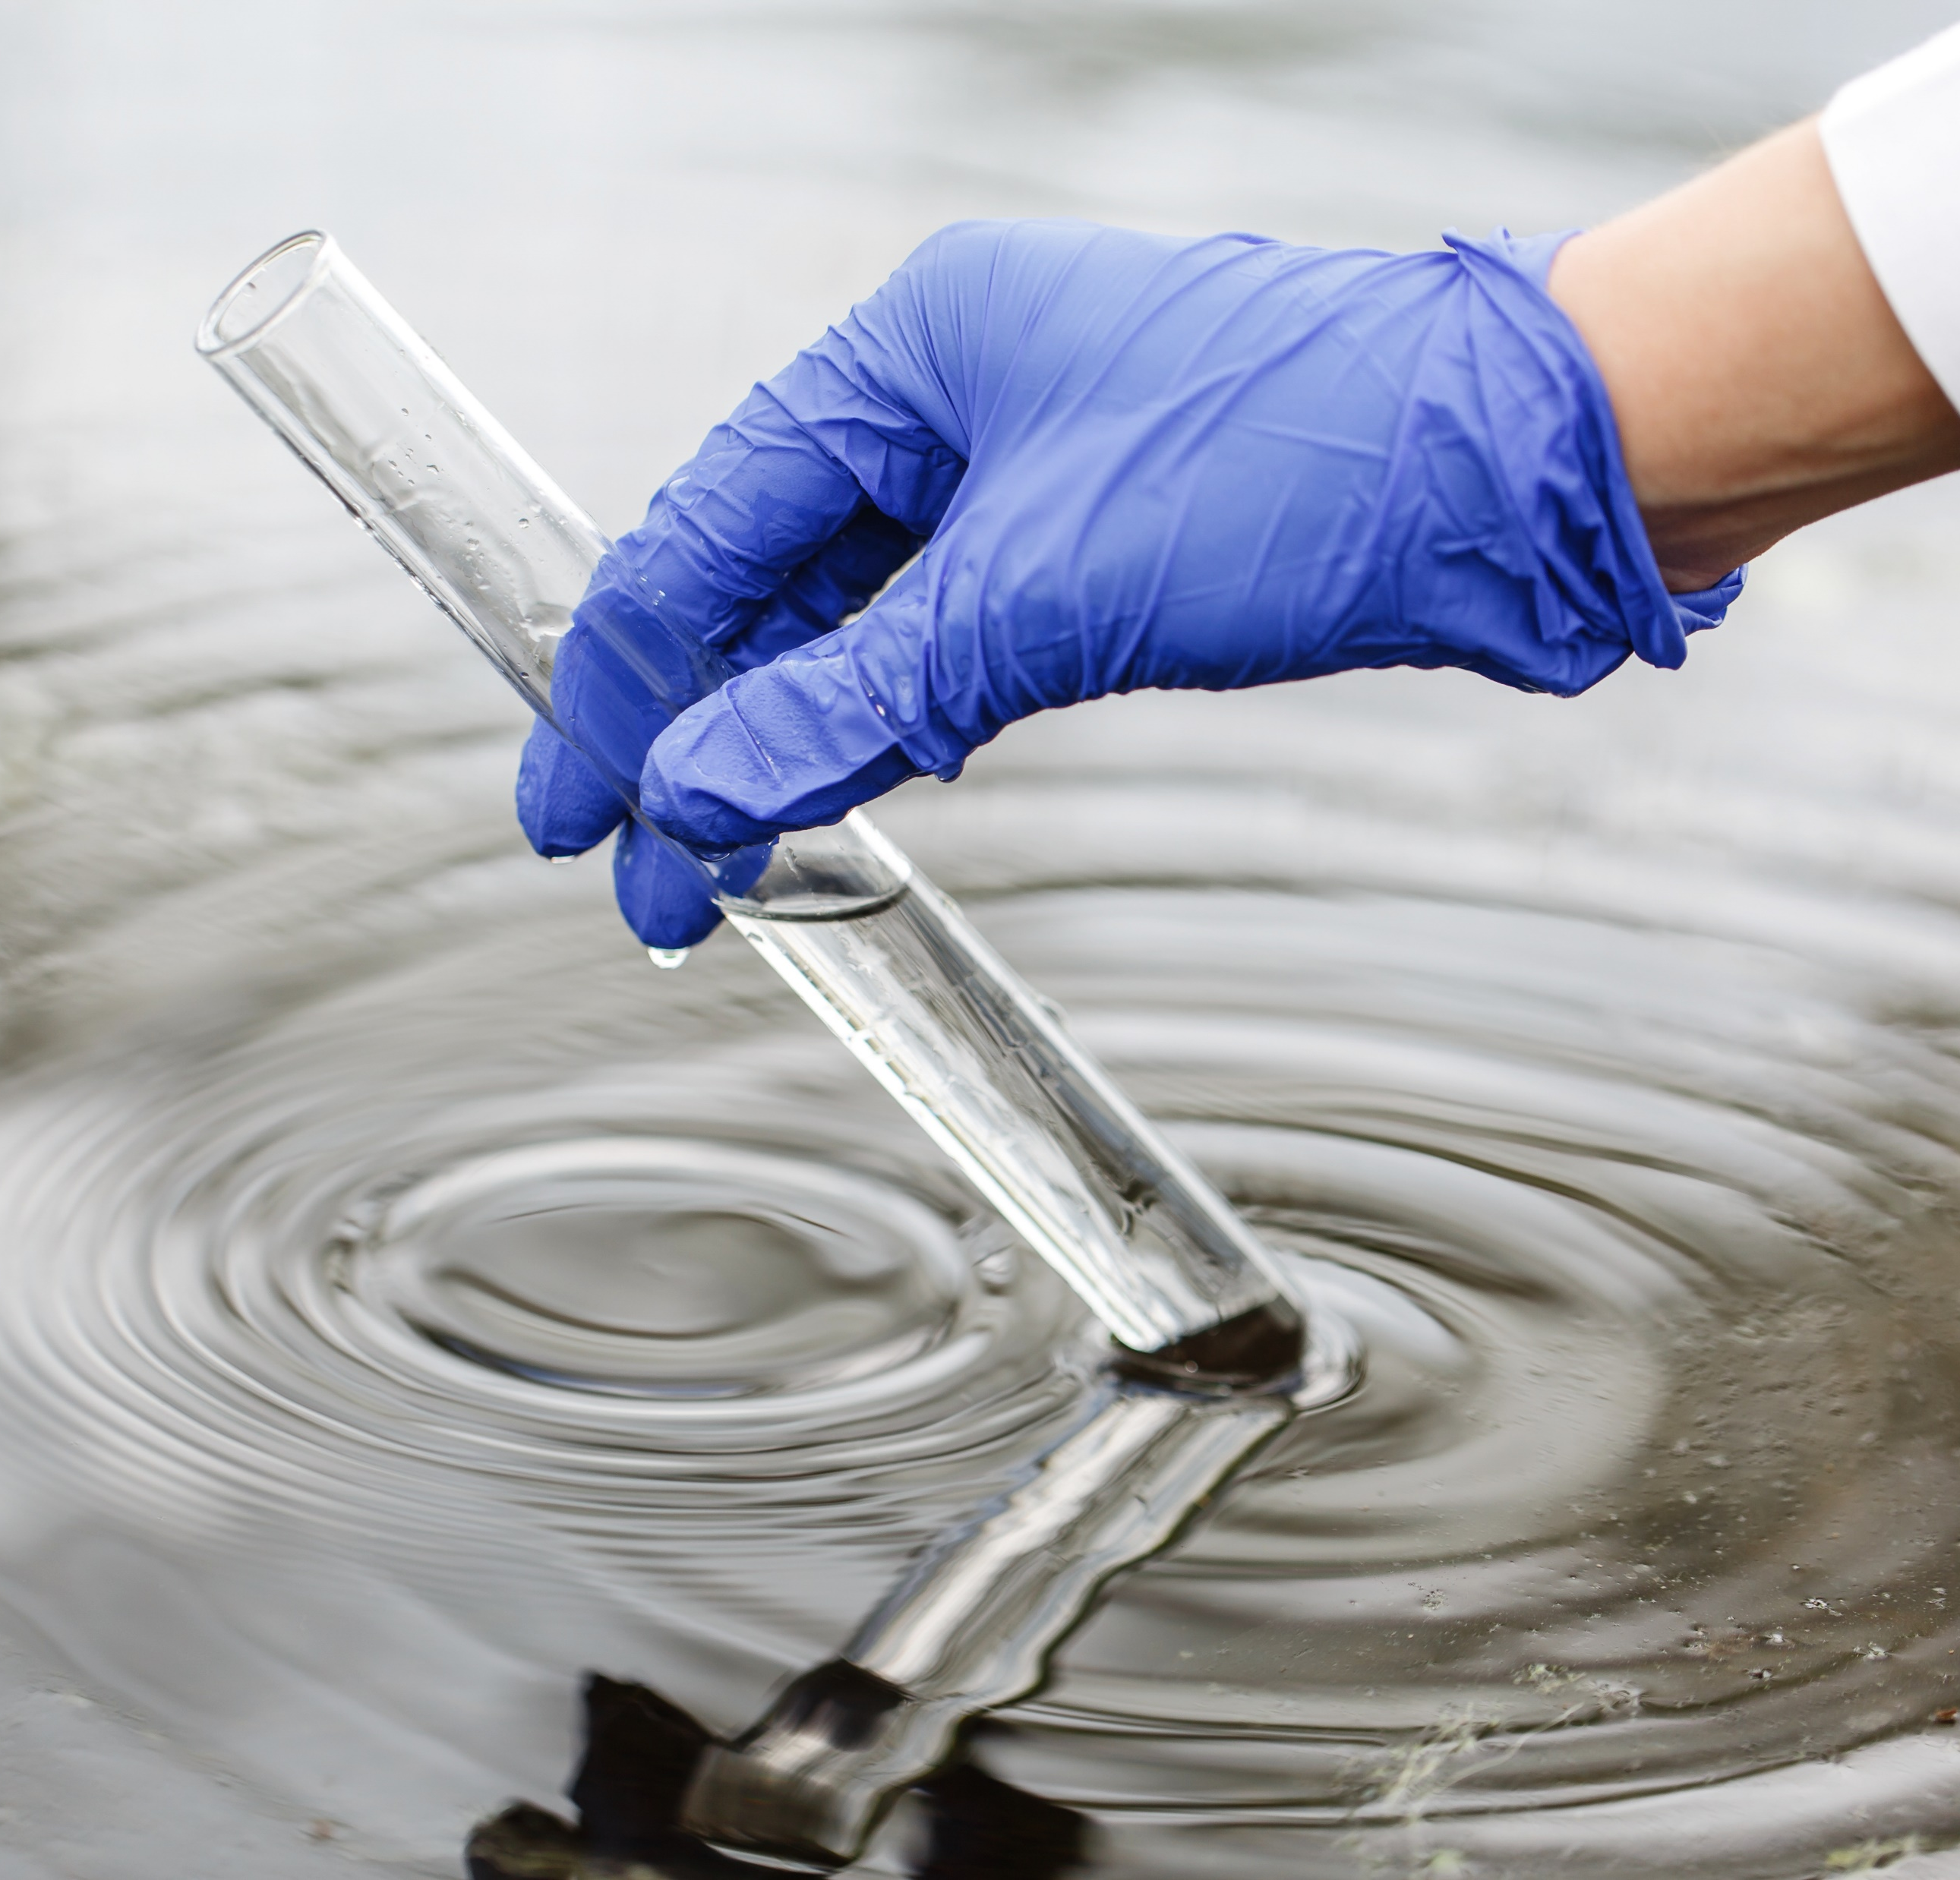
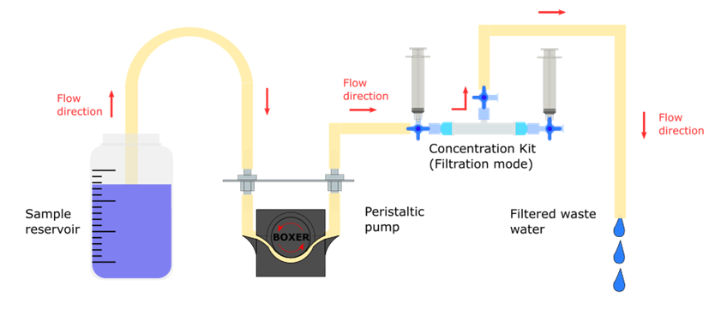
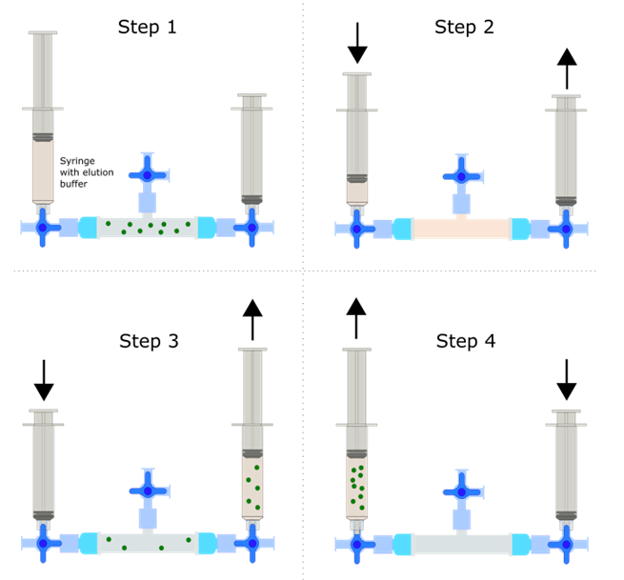
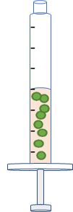
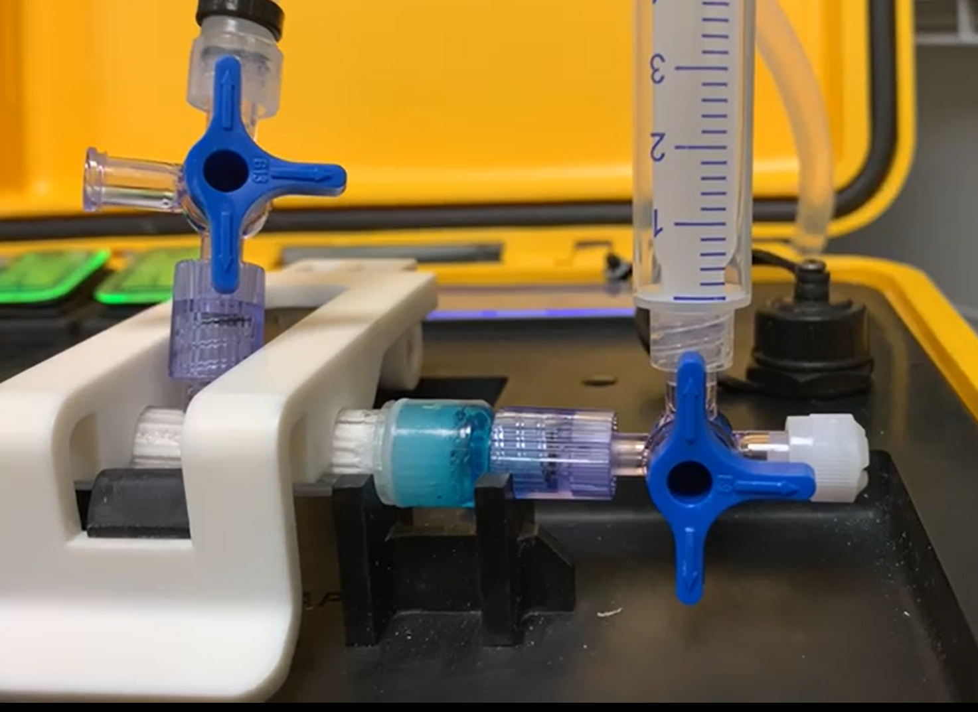
SXS-CON
Enhance rapidly the sensitivity and representativeness of your microbiological assessment by a pre-concentration step.
Portable concentrator system
Filtration Step : Microorganism trapping
Elution Step : Microorganism recovery
Concentrated sample
Plug the Concentration kit in the SX-CON.
Set up the valves in “Filtration Mode”.
Switch on the filtration button.
Switch off the filtration button when all sample has been filtered.
Once the sample is filtrated, the elution step recovers the microorganism from the filter for testing.
Two syringes are used to pass 5 mL of elution buffer back and forth the filter membrane.
The concentrated sample is ready for testing.

Slide 4
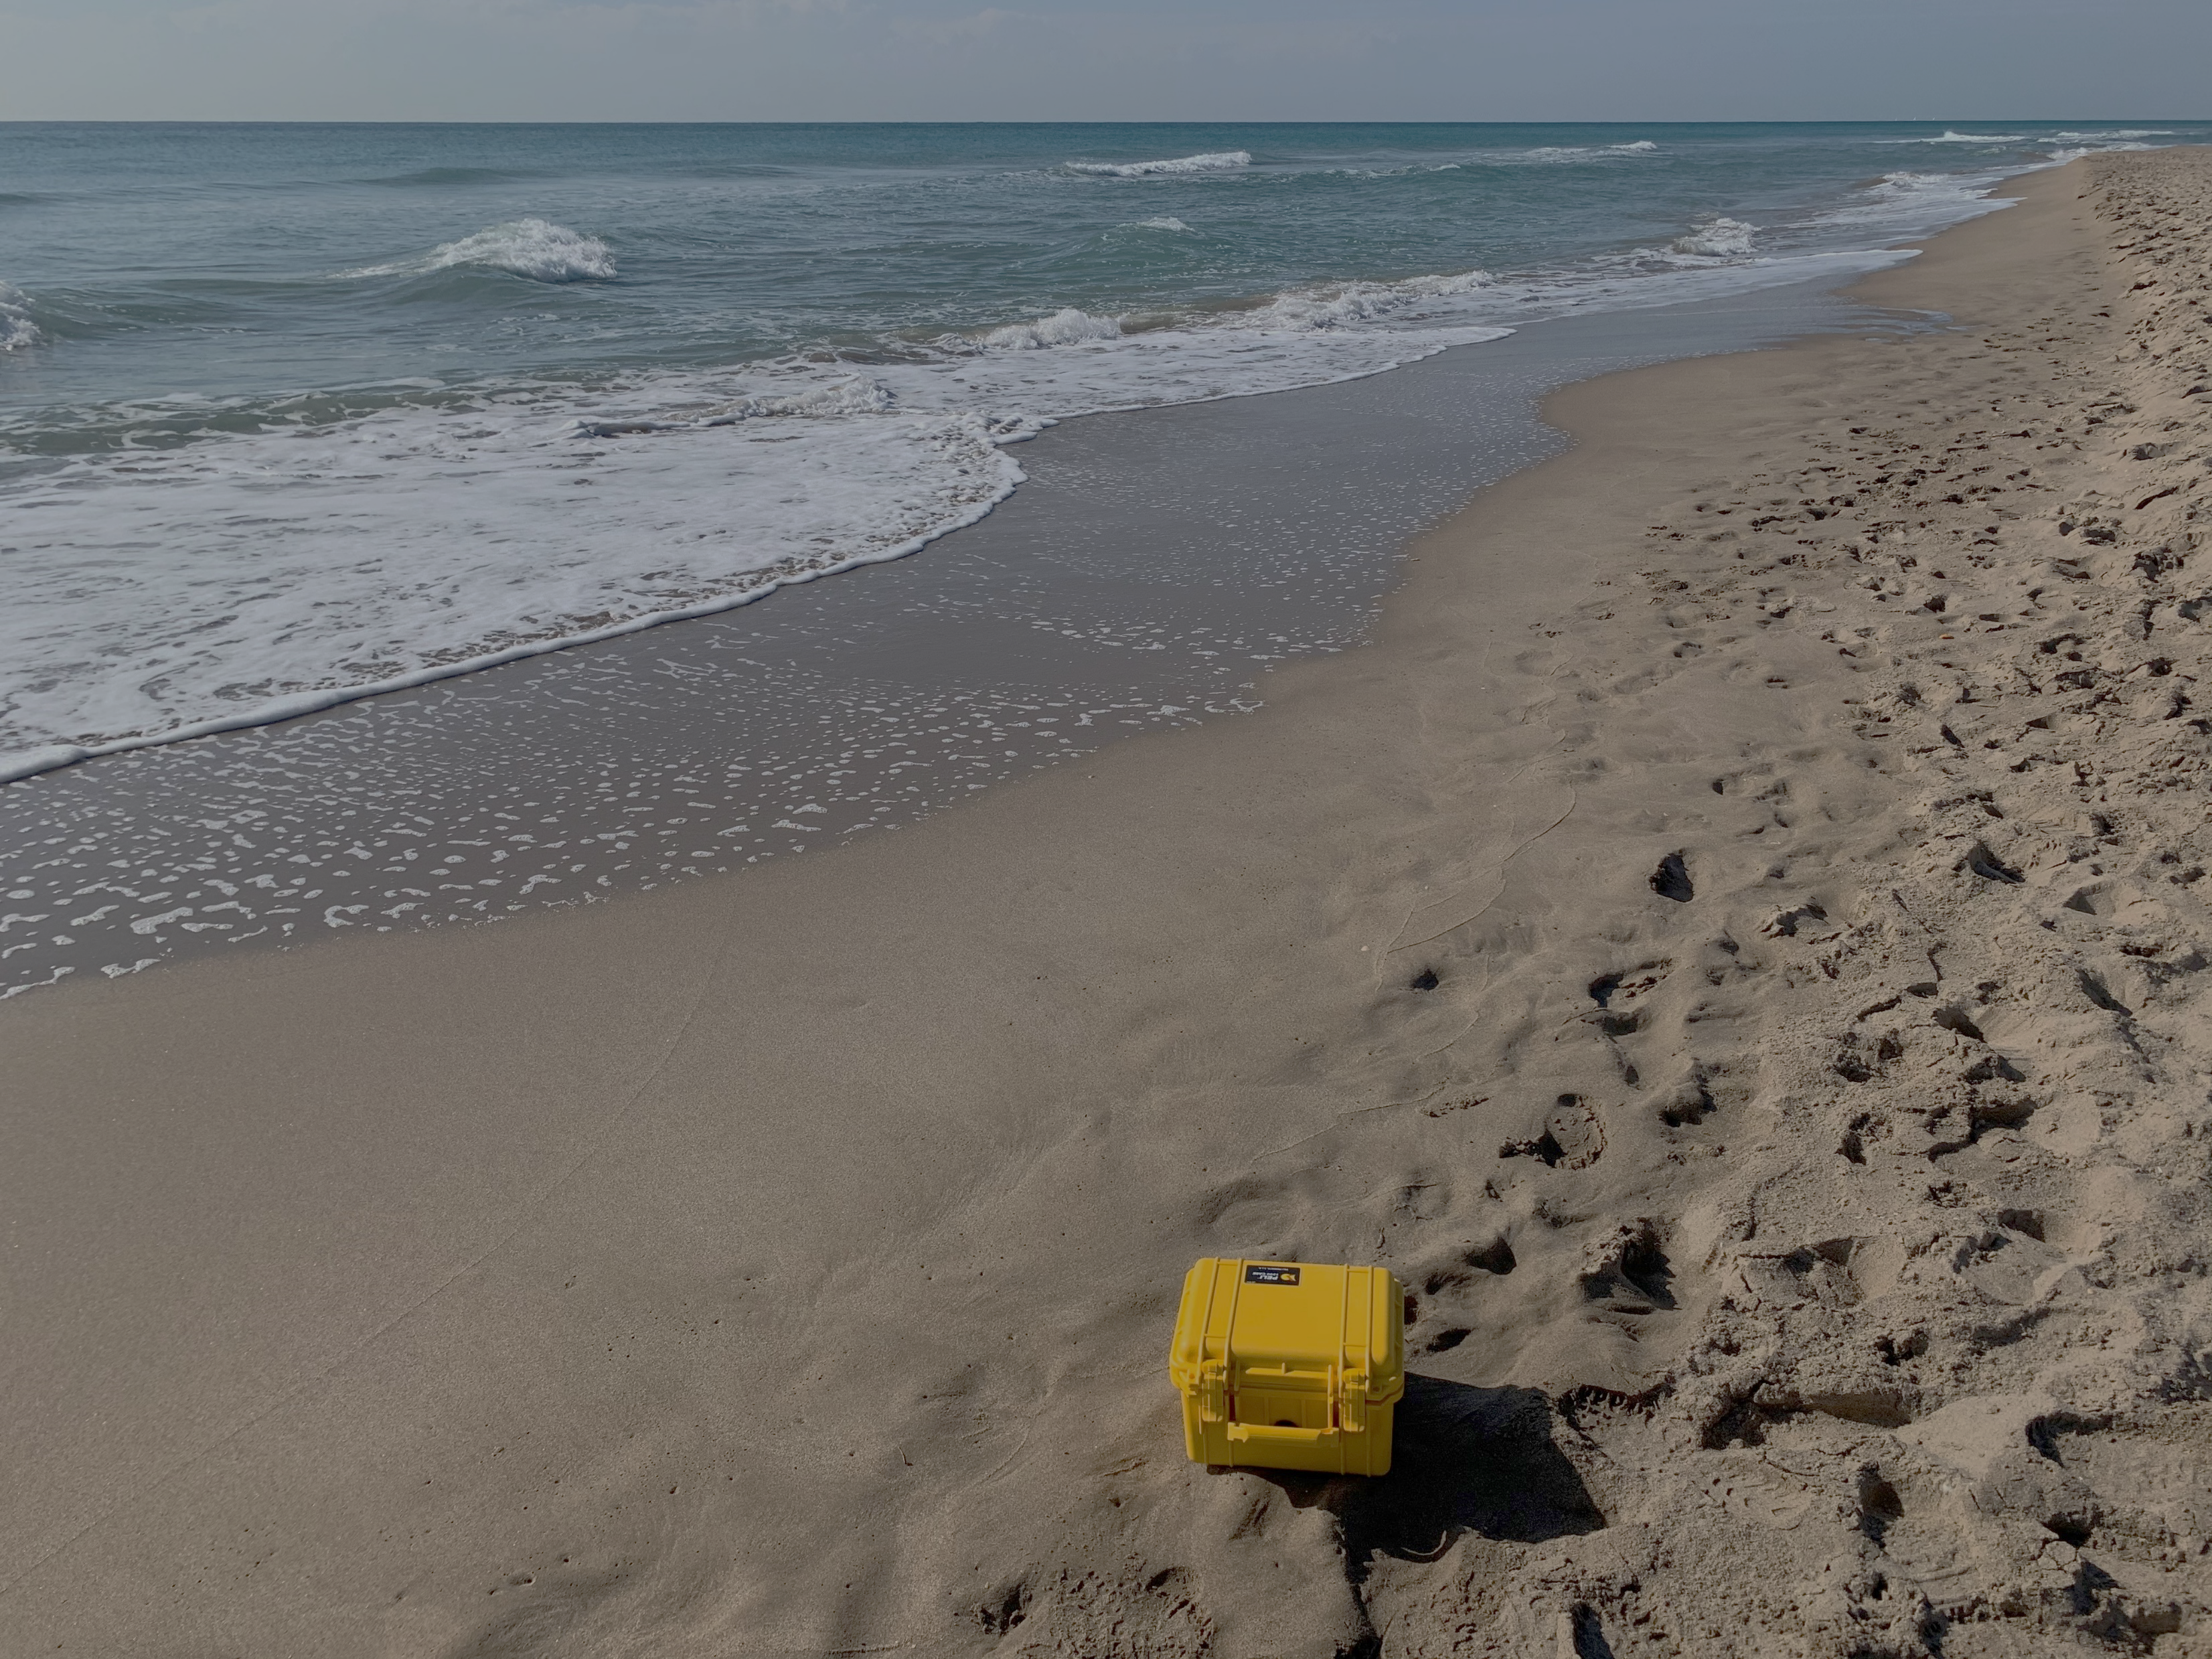
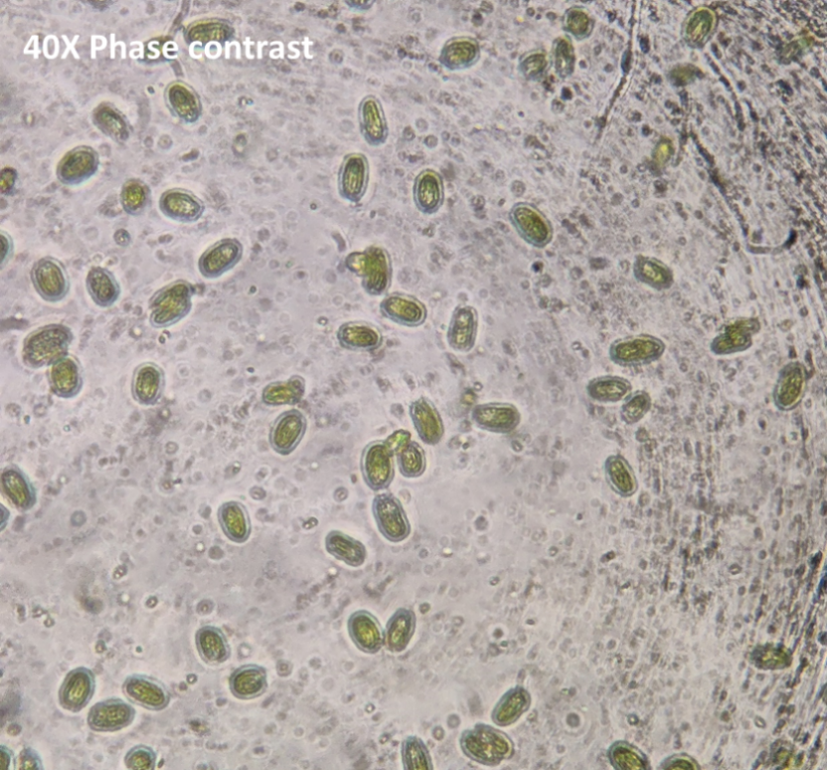
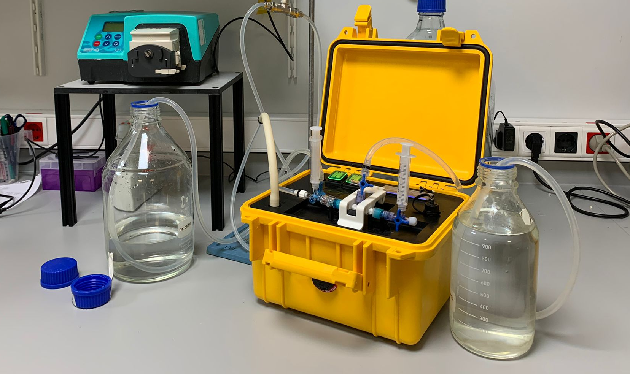
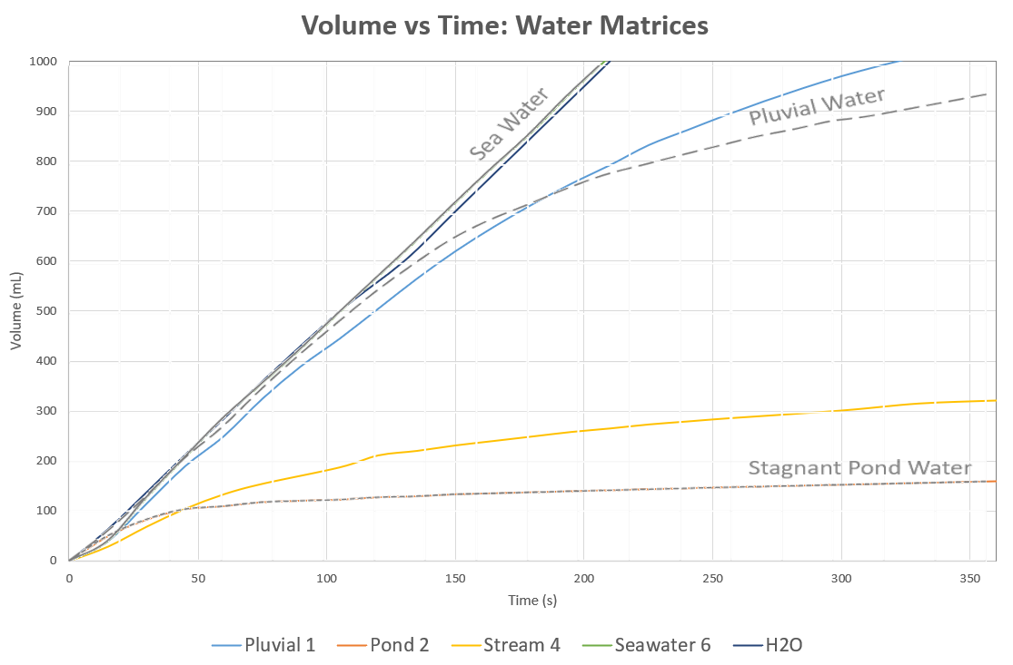
CONCENTRATOR SYSTEM FOR
ENHANCEMENT OF MICROBIOLOGICAL ASSESSMENT
CONCENTRATION RESULTS
An optimized concentration protocol has been developed during the testing campaign which filters 1L sample in less than 10 minutes, elutes to a volume of ~5.75mL providing a concentration factor (C-Factor) in average of:
C-Factor: x60 for Enterococci
C-Factor: x174 for E. coli
C-Factor: x255 for phytoplankton
Samples tested up to 264 NTU turbidity and salinity ranging from 0 to 37 PSU.
BATHING WATERS
Application Note: SX-CON in bathing waters
Parameter | Phyto Plankton
Samples 1-5
Filtered % 1 | 100
Filtered % 2 | 100
Filtered % 3 | 100
Filtered % 4 | 100
Filtered % 5 | 100
Recovery % 1 | 148.4 *
Recovery % 2 | 113.3 *
Recovery % 3 | 96.0
Recovery % 4 | 143.2 *
Recovery % 5 | 184.0 *
C-Factor 1 | 258.0
C-Factor 2 | 197.0
C-Factor 3 | 167.0
C-Factor 4 | 249.0
C-Factor 5 | 320.0
Samples – 1 liter/sample
Bacteria recovery
industrial water, fresh water and beverage quality control.
Sample | NTU | PSU (Salinity)
H20 | 0 | 0
Pluvial 1 | 3.25 | 0.6
Pond 2 | 263.33 | 1.5
Pond 3 | 15.50 | 4.1
Stream 4 | 44.07 | 10
River 5 | 5.16 | 27.4
Seawater 6 | 5.79 | 34.1
Stream 7 | 7.22 | 27.3
Seawater 8 | 31.67 | 36.6
Pluvial 9 | 16.21 | 36.1
Overflow 10 | 4.82 | 36.9
Parameter | E.coli | Enterococci
Samples 1,2,3
Filtered % 1 | 85 | 100
Filtered % 2 | 100 | 100
Filtered % 3 | 100 | 100
Recovery % 1 | 116.5 | 36.0
Recovery % 2 | 121.5 | 18.0
Recovery % 3 | 98.1 | 18.0
C-Factor 1 | 165.0 | 60.0
C-Factor 2 | 202.5 | 30.0
C-Factor 3 | 163.5 | 30.0
Figure showing a microscope image (x40 objective, phase contrast microscope) of the stock sample of phytoplankton containing Nannochloropsis gaditana (50%) size range 1-5 µm and Tetraselmis sueccia (50%) size range 3.5-25 µm.
* Recovery rates > 100% are considered equal or very close to 100%. Excess is due to intrinsic error in the measurement of the initial concentration.
Recovery rates have been measured by IDEXX Colilert ® and Enterolert ®.
The SX-CON concentrator has been tested processing real samples from bathing waters, coastal and inland waters in a high salinity range (including fresh, brackish and sea water), by analysing the concentrator factor achieved for each target bathing class (E.Coli , Enterococci and phytoplankton) in each relevant water matrix.
Real samples from beaches, deltas and inland waters,
Including fresh, water, sea water and brackish waters
Graph of filtration performance of different bathing water matrices
“SX-CON has been found suitable for any kind of targeted bathing water matrix providing concentration factors from x50 up to x255 by processing 1 liter in 10 minutes per sample.
This proof of concept enables the use of SX-CON to reduce time to test result, increase representativeness and sensitivity of standard analysis, including Defined Substrate Technology (DST) or standard culture assessment., performed continuously by bathing water quality authorities.”
Experiment setup (up). Eluted samples and raw samples – turbidity comparison (bottom) with sea water on the left (MZB) and brackish on the right (DPL).

Slide 5
BACKUP SLIDES

Slide 6
SXS-CON
Enhance rapidly the sensitivity and representativeness of your microbiological assessment by a pre-concentration step.
Portable concentrator system
4
Concentration Kit – Sterilized disposables *
2
3
 | 3x Luer lock 3-port valves
 | 1x Mesh disk filter <40µm
 | 2x Luer lock 5 ml syringes (with elution buffer)
 | 1x Celltrap filter
6
5
1
7
8
Concentrator - Internal features
1 | Integrated 24 W peristaltic pump
2 | LED status signal
3 | Celltrap filter holder
4 | LCD Display 2x16 pixels
5 | Internal vibration absorber
6 | Internal aluminium pillars
7 | Anti-condensation drainage holes
8 | Battery power bank with external Micro-USB battery charger
* Sterilized disposables are for only one use to avoid cross-contamination. Multi-use of disposables could be suitable for evaluation purposes.

Slide 7
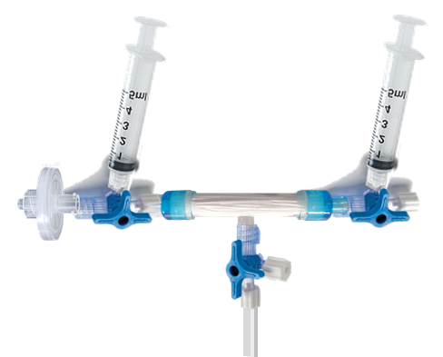
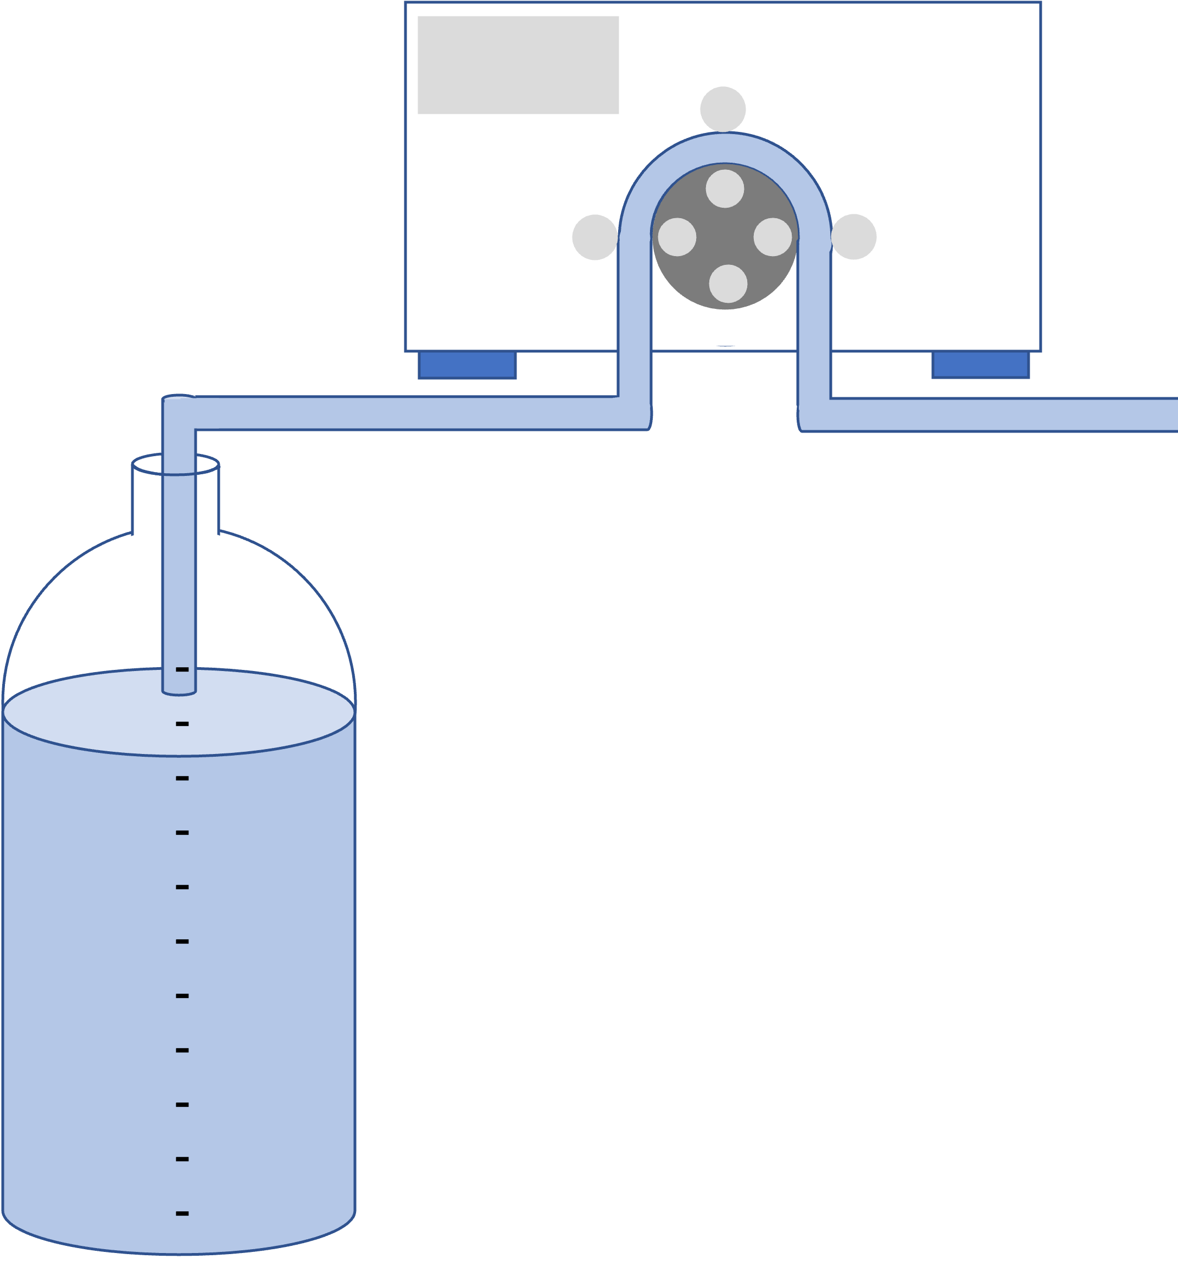
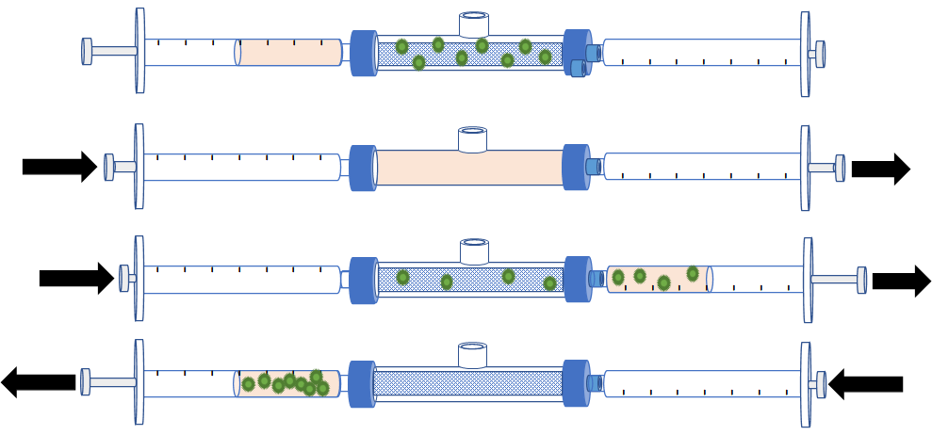
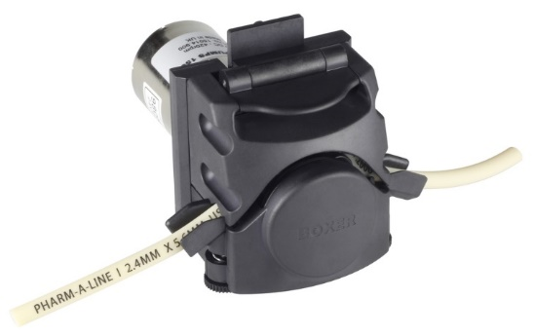
SXS-CON
Enhance rapidly the sensitivity and representativeness of your microbiological assessment by a pre-concentration step.
Portable concentrator system
Filtration Step : Microorganism trapping
Elution Step : Microorganism recovery
Trapped microorganims in the filter membrane
Concentration
Kit
Syringe with elution buffer
0.1 - 3 liters
water sample
Internal
Peristaltic Pump
Waste
Filtrated Water
Forth
Back
Plug the Concentration kit in the SX-CON.
Set up the valves in “Filtration Mode”.
Switch on the filtration button.
Switch off the filtration button when all sample has been filtered.
Once the sample is filtrated, the elution step recovers the microorganism from the filter for testing.
Two syringes are used to pass 5 mL of elution buffer back and forth the filter membrane.
The concentrated sample is ready for testing.
Concentrated sample

Slide 8
SXS-CON
Enhance rapidly the sensitivity and representativeness of your microbiological assessment by a pre-concentration step.
Portable concentrator system
Filtration Step : Microorganism trapping
Elution Step : Microorganism recovery
Concentrated sample
Plug the Concentration kit in the SX-CON.
Set up the valves in “Filtration Mode”.
Switch on the filtration button.
Switch off the filtration button when all sample has been filtered.
Once the sample is filtrated, the elution step recovers the microorganism from the filter for testing.
Two syringes are used to pass 5 mL of elution buffer back and forth the filter membrane.
The concentrated sample is ready for testing.

